Slide 1
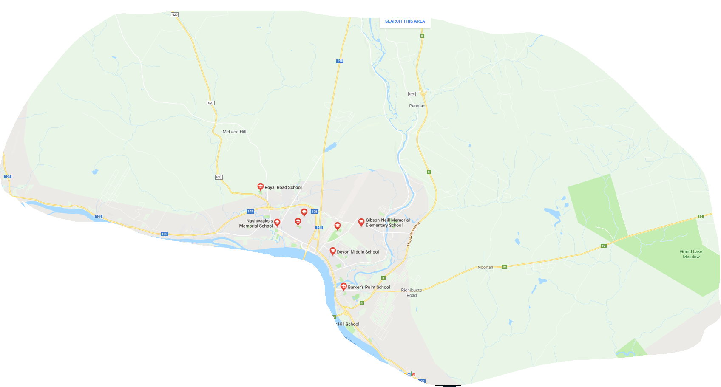
Sustainability Study Elementary Schools on the Northside of Fredericton

Slide 2
History
DEC wanted to examine the current structure and enrollment data of elementary schools on the north side of Fredericton
The Director of Finance and Administration, along with his team have compiled the following facts and have included recommendations to the DEC
Notes:
Should we add the date this motion was made?

Slide 3
Background
There are currently six elementary schools on the north side of Fredericton that were considered in this study. Barker’s Point Elementary School, Gibson Neill Memorial Elementary School, McAdam Avenue Elementary School, Nashwaaksis Memorial School, Park Street Elementary School and Royal Road Elementary School.
The current school structures have a combined functional capacity of 83% (current enrolment of 2129). Schools are considered full when they reach 80% (2054 students). The District notes that the north side of Fredericton is projected to continue to grow in the future.
There are currently nine mobile classrooms located at these six schools.

Slide 4
Objective
Given the current structures are over the combined functional capacity, we feel the need for the DEC to adopt a plan that will address both the projected growth in enrollment and pedagogical needs of the north side of Fredericton moving forward.
After closely analyzing the data collected, we have came up with scenarios that we feel will meet the district’s future needs.

Slide 5
Enrolment Projections
Projection 1 (Assuming no net migration) |  |  |  |  |  |  | Total
Year | K | 1 | 2 | 3 | 4 | 5
2016-17 | 345 | 367 | 394 | 358 | 354 | 311 | 2129
2017-18 | 322 | 345 | 367 | 394 | 358 | 354 | 2140
2018-19 | 330 | 322 | 345 | 367 | 394 | 358 | 2116
2019-20 | 298 | 330 | 322 | 345 | 367 | 394 | 2056
2020-21 | 310 | 298 | 330 | 322 | 345 | 367 | 1972
2021-22 | 345 | 310 | 298 | 330 | 322 | 345 | 1950
2022-23 | 348 | 345 | 310 | 298 | 330 | 322 | 1953
2023-24 | 362 | 348 | 345 | 310 | 298 | 330 | 1993
2024-25 | 373 | 362 | 348 | 345 | 310 | 298 | 2036
2025-26 | 379 | 373 | 362 | 348 | 345 | 310 | 2117
2026-27 | 381 | 379 | 373 | 362 | 348 | 345 | 2188
Projection 1 (Assuming 2% net migration) |  |  |  |  |  |  | Total
Year | K | 1 | 2 | 3 | 4 | 5
2016-17 | 345 | 367 | 394 | 358 | 354 | 311 | 2129
2017-18 | 348 | 352 | 374 | 402 | 365 | 361 | 2203
2018-19 | 357 | 355 | 359 | 382 | 410 | 372 | 2236
2019-20 | 322 | 364 | 362 | 366 | 389 | 418 | 2223
2020-21 | 335 | 329 | 371 | 370 | 373 | 397 | 2176
2021-22 | 373 | 342 | 335 | 379 | 377 | 381 | 2188
2022-23 | 377 | 381 | 349 | 342 | 386 | 385 | 2220
2023-24 | 392 | 384 | 388 | 356 | 349 | 394 | 2263
2024-25 | 404 | 400 | 392 | 396 | 363 | 356 | 2310
2025-26 | 410 | 412 | 408 | 400 | 404 | 370 | 2403
2026-27 | 412 | 418 | 420 | 416 | 408 | 412 | 2486
Projection 1 (Extrapolated city projections) |  |  |  |  |  |  | Total
Year | K | 1 | 2 | 3 | 4 | 5
2016-17 | 312 | 320 | 309 | 316 | 306 | 281 | 1844
2017-18 | 319 | 326 | 332 | 319 | 327 | 310 | 1933
2018-19 | 338 | 332 | 339 | 341 | 330 | 331 | 2011
2019-20 | 361 | 351 | 344 | 348 | 352 | 333 | 2089
2020-21 | 381 | 374 | 363 | 353 | 359 | 355 | 2185
2021-22 | 399 | 395 | 387 | 372 | 364 | 362 | 2279
2022-23 | 413 | 413 | 409 | 397 | 383 | 367 | 2382
2023-24 | 427 | 428 | 427 | 419 | 408 | 386 | 2495
2024-25 | 438 | 443 | 442 | 438 | 431 | 411 | 2603
2025-26 | 445 | 454 | 458 | 453 | 450 | 434 | 2694
2026-27 | 447 | 462 | 470 | 469 | 467 | 454 | 2769
Based on EY Report on forecasted Births from city projections
Based on birth rates for year (forwarded to when they should start school)
Actual September 2016 Enrolment

Slide 6
Barker’s Point Elementary School
Barker's Point School
Total Enrolment by Grade
Enrolment Year | K | 1 | 2 | 3 | 4 | 5 | Total
2011-12 | 53 | 62 | 59 | 58 | 48 | 71 | 351
2012-13 | 54 | 47 | 61 | 56 | 52 | 45 | 315
2013-14 | 76 | 59 | 47 | 63 | 47 | 50 | 342
2014-15 | 59 | 71 | 61 | 47 | 58 | 55 | 351
2015-16 | 57 | 59 | 71 | 56 | 46 | 56 | 345
Barker's Point Elementary School
Functional Capacity
100% | 80% | 2016-17 Enrolment | Over/Under 80%
432 | 346 | 347 | 1
Operational Costs
 |  | Electricity |  |  | $ 46,720.04
 |  | Water/Sewage |  |  | $ 3,148.16
 |  | Garbage Removal |  |  | $ 1,666.44
 |  | Snow Plowing |  |  | $ 7,077.84
 |  | Heating Fuel |  |  | $ 17,560.34
 |  | Natural Gas |  |  | $ -
 |  | Cleaning Supplies/Services |  |  | $ 5,571.70
 |  | Minor Repairs/Renovations |  |  | $ 14,555.47
 |  | Total |  |  | $ 96,299.99
 |  | Operational Costs Per Square Meter |  |  |  | $ 26.82
 |  | Based on: | 3590 | Sq Meters
 |  | Operational Costs Per Student |  |  |  | $ 277.52
 |  | Based on: | 347 | Enrollment

Slide 7
Gibson Neill Memorial Elementary School
Gibson Neill Elementary School
Total Enrolment by Grade
Enrolment Year | K | 1 | 2 | 3 | 4 | 5 | Total
2011-12 | 79 | 93 | 88 | 88 | 83 | 70 | 501
2012-13 | 88 | 85 | 96 | 87 | 86 | 79 | 521
2013-14 | 101 | 97 | 85 | 97 | 95 | 90 | 565
2014-15 | 120 | 107 | 91 | 89 | 100 | 91 | 598
2015-16 | 101 | 113 | 109 | 92 | 87 | 104 | 606
Gibson Neill Memorial Elementary School
Functional Capacity
100% | 80% | 2016-17 Enrolment | Over/Under 80%
624 | 499 | 615 | 116
Operational Costs
 |  | Electricity |  |  | $ 61,705.05
 |  | Water/Sewage |  |  | $ 8,149.67
 |  | Garbage Removal |  |  | $ 2,748.24
 |  | Snow Plowing |  |  | $ 15,277.80
 |  | Heating Fuel |  |  | $ -
 |  | Natural Gas |  |  | $ 47,050.89
 |  | Cleaning Supplies/Services |  |  | $ 13,427.64
 |  | Minor Repairs/Renovations |  |  | $ 6,965.07
 |  | Total |  |  | $ 155,324.36
 |  | Operational Costs Per Square Meter |  |  |  | $ 21.22
 |  | Based on: | 7318 | Sq Meters
 |  | Operational Costs Per Student |  |  |  | $ 252.56
 |  | Based on: | 615 | Enrollment

Slide 8
McAdam Avenue Elementary School
McAdam Avenue School
Total Enrolment by Grade
Enrolment Year | K | 1 | 2 | 3 | 4 | 5 | Total
2011-12 | 19 | 19 | 18 | 11 | 18 | 13 | 98
2012-13 | 11 | 14 | 17 | 13 | 13 | 17 | 85
2013-14 | 12 | 11 | 14 | 17 | 13 | 11 | 78
2014-15 | 16 | 10 | 14 | 11 | 17 | 15 | 83
2015-16 | 14 | 16 | 9 | 11 | 11 | 18 | 79
McAdam Avenue Elementary School
Functional Capacity
100% | 80% | 2016-17 Enrolment | Over/Under 80%
216 | 173 | 74 | -99
Operational Costs
 |  | Electricity |  |  | $ 5,544.68
 |  | Water/Sewage |  |  | $ 795.04
 |  | Garbage Removal |  |  | $ 380.04
 |  | Snow Plowing |  |  | $ 6,522.78
 |  | Heating Fuel |  |  | $ -
 |  | Natural Gas |  |  | $ 13,644.85
 |  | Cleaning Supplies/Services |  |  | $ 1,274.77
 |  | Minor Repairs/Renovations |  |  | $ 7,596.80
 |  | Total |  |  | $ 35,758.96
 |  | Operational Costs Per Square Meter |  |  |  | $ 24.82
 |  | Based on: | 1441 | Sq Meters
 |  | Operational Costs Per Student |  |  |  | $ 483.23
 |  | Based on: | 74 | Enrollment

Slide 9
Nashwaaksis Memorial School
Nashwaaksis Memorial School
Total Enrolment by Grade
Enrolment Year | K | 1 | 2 | 3 | 4 | 5 | Total
2011-12 | 37 | 49 | 37 | 33 | 39 | 41 | 236
2012-13 | 51 | 30 | 42 | 26 | 31 | 31 | 211
2013-14 | 43 | 49 | 32 | 42 | 27 | 32 | 225
2014-15 | 45 | 43 | 48 | 36 | 41 | 34 | 247
2015-16 | 66 | 45 | 45 | 44 | 34 | 38 | 272
Nashwaaksis Memorial Elementary School
Functional Capacity
100% | 80% | 2016-17 Enrolment | Over/Under 80%
336 | 269 | 280 | 11
Operational Costs
 |  | Electricity |  |  | $ 42,329.63
 |  | Water/Sewage |  |  | $ 3,417.52
 |  | Garbage Removal |  |  | $ 1,096.32
 |  | Snow Plowing |  |  | $ 23,277.78
 |  | Heating Fuel |  |  | $ -
 |  | Natural Gas |  |  | $ -
 |  | Cleaning Supplies/Services |  |  | $ 7,224.38
 |  | Minor Repairs/Renovations |  |  | $ 17,537.64
 |  | Total |  |  | $ 94,883.27
 |  | Operational Costs Per Square Meter |  |  |  | $ 26.71
 |  | Based on: | 2910 | Sq Meters
 |  | Operational Costs Per Student |  |  |  | $ 277.56
 |  | Based on: | 280 | Enrollment

Slide 10
Park Street Elementary School
Park Street Elementary School
Total Enrolment by Grade
Enrolment Year | K | 1 | 2 | 3 | 4 | 5 | Total
2011-12 | 53 | 73 | 61 | 83 | 73 | 83 | 426
2012-13 | 62 | 57 | 75 | 70 | 84 | 77 | 425
2013-14 | 67 | 63 | 58 | 80 | 70 | 83 | 421
2014-15 | 68 | 64 | 63 | 51 | 78 | 71 | 395
2015-16 | 63 | 74 | 62 | 70 | 49 | 77 | 395
Park Street Elementary School
Functional Capacity
100% | 80% | 2016-17 Enrolment | Over/Under 80%
504 | 403 | 408 | 5
Operational Costs
 |  | Electricity |  |  | $ 33,242.19
 |  | Water/Sewage |  |  | $ 4,372.24
 |  | Garbage Removal |  |  | $ 2,051.40
 |  | Snow Plowing |  |  | $ 11,664.72
 |  | Heating Fuel |  |  | $ -
 |  | Natural Gas |  |  | $ 35,838.23
 |  | Cleaning Supplies/Services |  |  | $ 8,933.47
 |  | Minor Repairs/Renovations |  |  | $ 11,898.71
 |  | Total |  |  | $ 108,000.96
 |  | Operational Costs Per Square Meter |  |  |  | $ 26.12
 |  | Based on: | 4135 | Sq Meters
 |  | Operational Costs Per Student |  |  |  | $ 264.71
 |  | Based on: | 408 | Enrollment

Slide 11
Royal Road Elementary School
Royal Road Elementary School
Total Enrolment by Grade
Enrolment Year | K | 1 | 2 | 3 | 4 | 5 | Total
2011-12 | 69 | 63 | 56 | 73 | 68 | 65 | 394
2012-13 | 80 | 71 | 70 | 55 | 82 | 74 | 432
2013-14 | 64 | 75 | 70 | 64 | 59 | 81 | 413
2014-15 | 72 | 55 | 80 | 67 | 62 | 55 | 391
2015-16 | 63 | 71 | 56 | 81 | 76 | 66 | 413
Royal Road Elementary School
Functional Capacity
100% | 80% | 2016-17 Enrolment | Over/Under 80%
456 | 365 | 405 | 40
Operational Costs
 |  | Electricity |  |  | $ 72,314.46
 |  | Water/Sewage |  |  | $ 4,533.28
 |  | Garbage Removal |  |  | $ 2,032.08
 |  | Snow Plowing |  |  | $ 14,765.22
 |  | Heating Fuel |  |  | $ -
 |  | Natural Gas |  |  | $ -
 |  | Cleaning Supplies/Services |  |  | $ 2,311.45
 |  | Minor Repairs/Renovations |  |  | $ 8,003.79
 |  | Total |  |  | $ 103,960.28
 |  | Operational Costs Per Square Meter |  |  |  | $ 24.20
 |  | Based on: | 4295 | Sq Meters
 |  | Operational Costs Per Student |  |  |  | $ 256.69
 |  | Based on: | 405 | Enrollment

Slide 12
Recommendations
Based on the fact that the current structures are over their combined functional capacity, we feel it is necessary for the addition of two new elementary schools on the north side of Fredericton.
Our proposed locations would balance the student populations amongst existing schools and allow for future growth in the north side area.

Slide 13
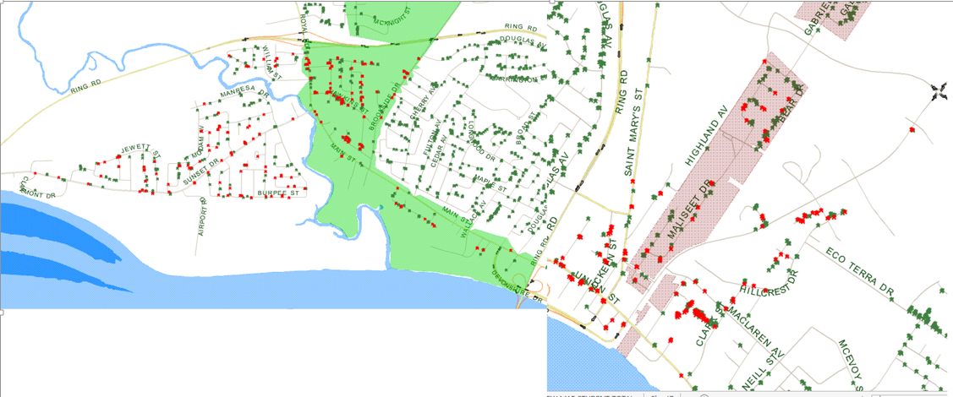
New Elementary School in the McAdam Road area – Potential School Boundary (students in red)

Slide 14
New Elementary School in the McAdam Road area
Standard elementary schools are designed with a functional capacity of 500 students when at 100% capacity (400 students at 80%).
The proposed boundary would see approximately 357 students zoned for this school, giving it a functional capacity of 71%.
Depending on location, there is potential for many of these students continuing to be walkers (under 2.4km from the school).
Notes:
This particular school would draw from GNMES, MAES, and NSMES.

Slide 15
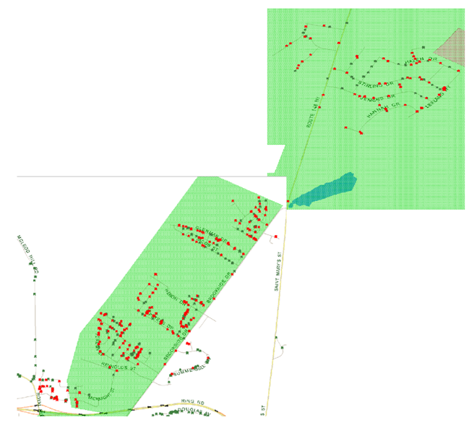
New Elementary School in the Kilarney Road area – Potential School Boundary (students in red)

Slide 16
New Elementary School in the Kilarney Road area
Standard elementary schools are designed with a functional capacity of 500 students when at 100% capacity (400 students at 80%).
The proposed boundary would see approximately 363 students zoned for this school, giving it a functional capacity of 73%.
Depending on location, there is potential for many of these students becoming eligible walkers (under 2.4km from the school).

Slide 17
Impact on Other Schools
These scenarios would see a recommendation of closing or addition to the current McAdam Avenue Elementary School and the closure of Nashwaaksis Memorial School.
It would also alleviate a lot of the overcrowding at the six elementary schools.
Most of the nine portable classrooms currently in place, would be removed.

Slide 18
Impact on School Enrolments and Functional Capacities
 | 2016-17 Enrolment | 2016-17 Functional Capacity
Barker's Point Elementary School | 347 | 80%
Gibson Neill Memorial Elementary School | 615 | 99%
Park Street Elementary School | 408 | 81%
Royal Road Elementary School | 405 | 89%
McAdam Avenue Elementary School | 74 | 34%
NashWaaksis Memorial Elementary School | 280 | 83%
 | Proposed Enrolment | Proposed Functional Capacity
Barker's Point Elementary School | 345 | 80%
Gibson Neill Memorial Elementary School | 481 | 77%
Park Street Elementary School | 286 | 57%
Royal Road Elementary School | 356 | 78%
New McAdam Avenue area Elementary School | 357 | 71%
New Kilarney Road area Elementary School | 363 | 73%

Slide 19
Recap
We feel that the population will grow more on the north side of Fredericton, then it will on the south side. E&Y and The City of Fredericton personnel estimated that 50% of future population growth would happen on the north side and 50% on the south side.
Our current schools would achieve the 80% functional capacity mark when their student enrolments reached 2054 students. Currently the student enrolment for these schools is 2129 students, with a functional capacity of 83%. The addition of the two proposed new schools would see the 80% functional capacity increased to 2412 students. Using the current enrollment, the functional capacity would be at 71% (with no new growth).
These proposed school boundaries have all elementary schools at an 80% functional capacity or less, with only one being below the “optimal 60 – 80%” mark.
Allows for room at PSES for future boundary changes to a more centralized location on the north side. I.e. Should GNMES continue to grow, you could easily add students into PSES.
This should see most portable classrooms (with exception of BPES), removed.

Slide 20
Questions

